Slide 1

USING DEEP LEARNING TO PREDICT OVERALL SURVIVAL TIMES FOR BREAST CANCER FROM H&E-STAINED WHOLE SLIDE BIOPSY IMAGES
By - Anirbit Ghosh 2439281G

Slide 2
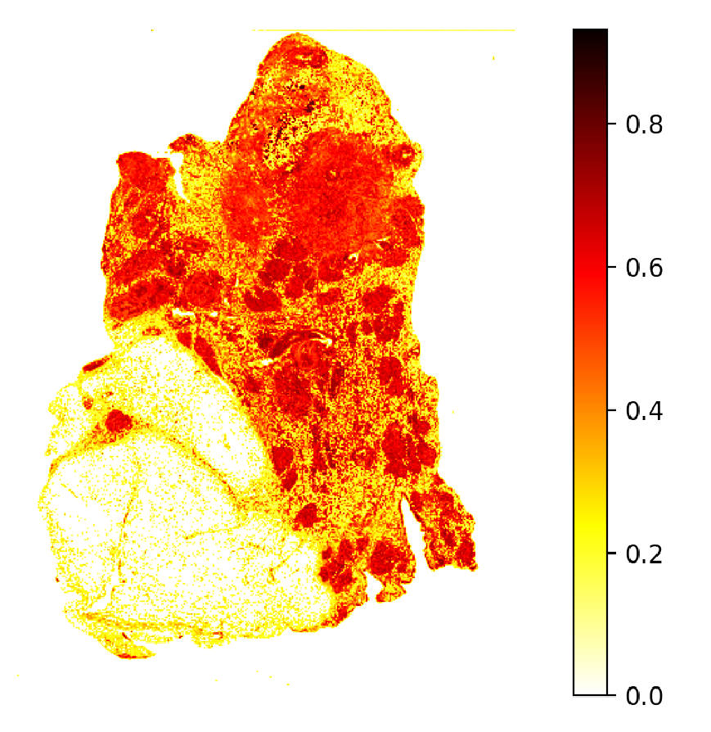
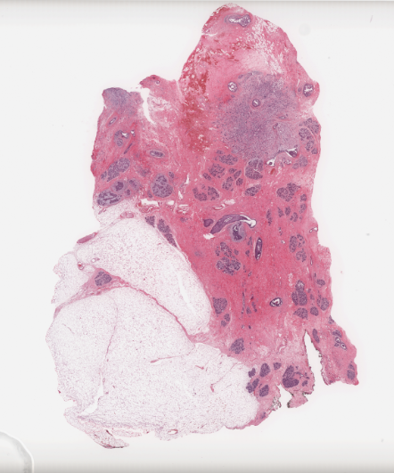
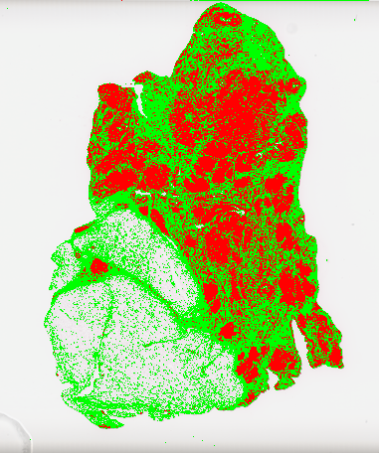
Mean Malignant Intensity
Classification
Regression
Survival Duration (months) | Predicted survival (months)
76.47 | 51.35
Survival Prediction
Malignancy Spread Score
Breast tissue biopsy slide image

Slide 3
What is the motivation behind doing our project?

Slide 4
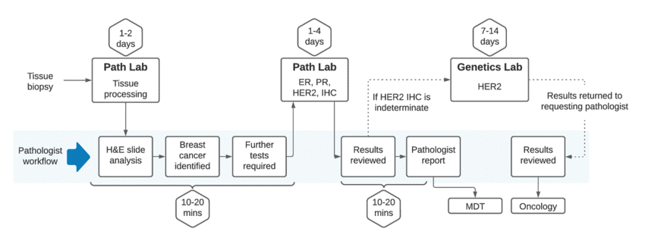
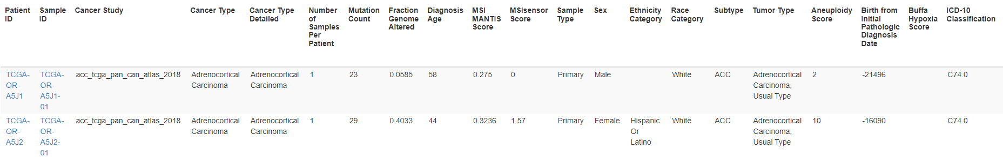
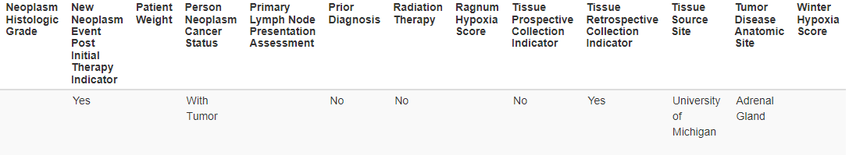
Diagnostic workflow
Clinical data collected for prognosis estimation

Slide 5
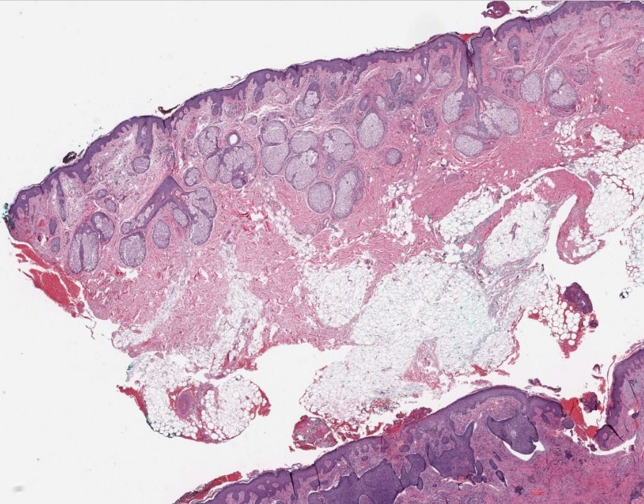
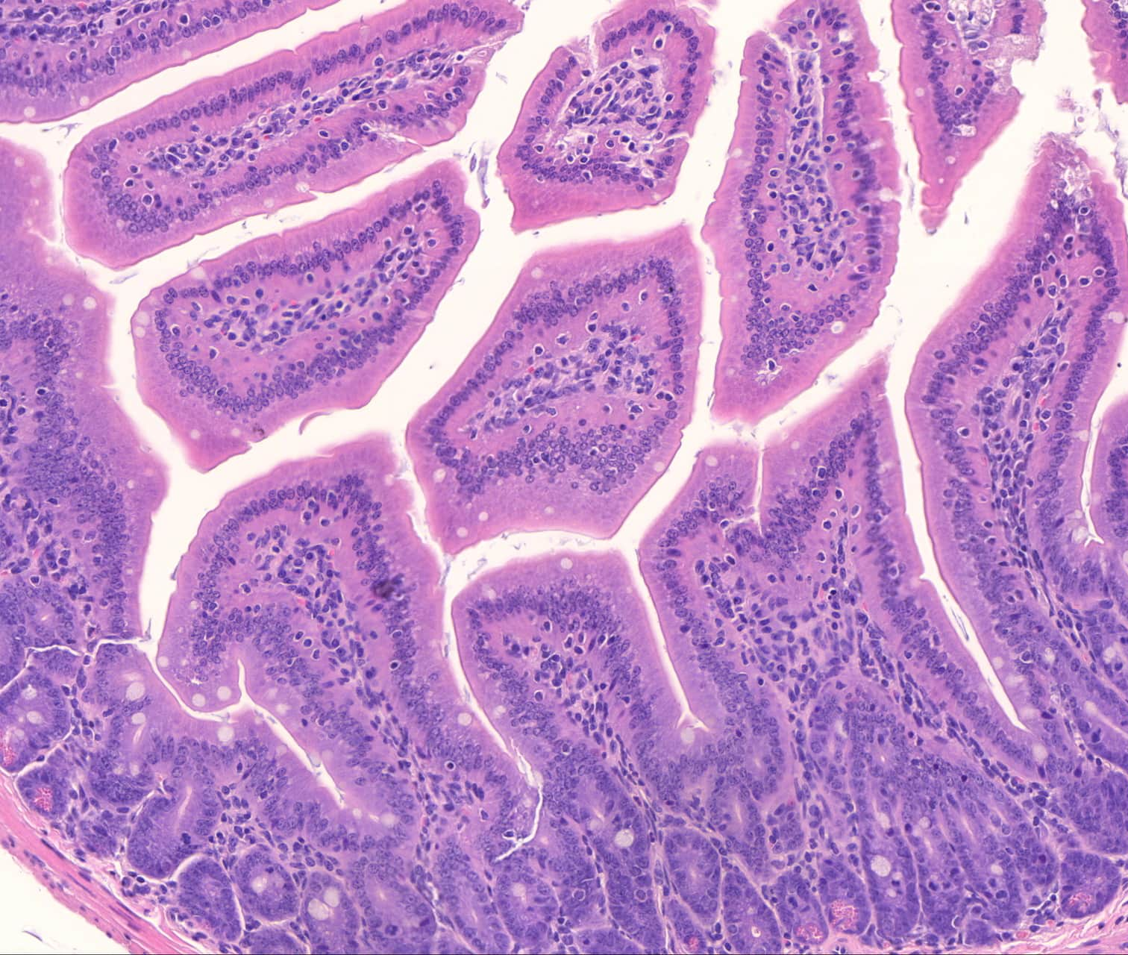
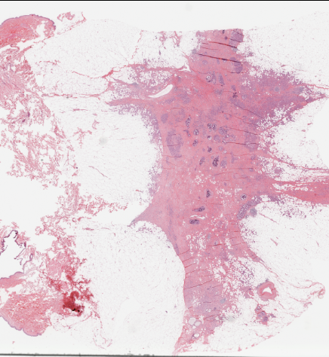
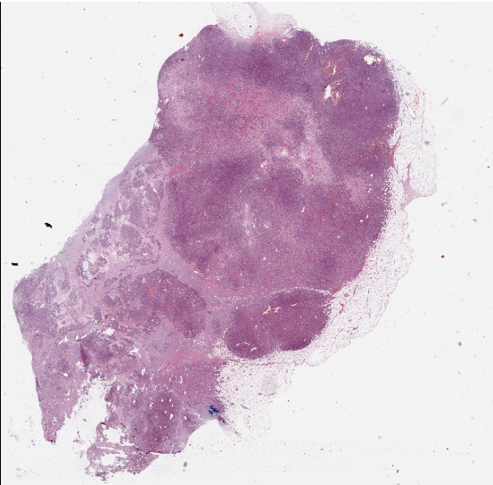
Whole Slide Images of biopsied tissue

Slide 6
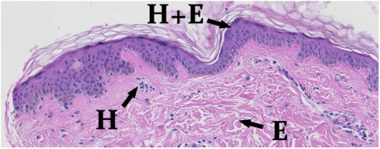
Whole Slide Images: Biopsied tissue blocks are sliced into thin sections, mounted on glass slides and stained with a dye. The physical glass slides are scanned and digitized into a high-resolution image.
H&E staining
Hematoxylin (H): Highlights nuclei of cells with a blue hue.
Eosin (E): Highlights connective tissue and cytoplasm with hues of red.

Slide 7
What is The Overall problem We are trying to solve ?

Slide 8
Project aims
Can be broken down into two separate tasks:
Diagnostic stage – Identification of malignant tumor regions from H&E-stained whole slide images of breast tissue.
Prognostic stage – Investigate the viability of whole slide images in estimating overall survival time of patients based on disease severity extracted from their biopsy image.

Slide 9
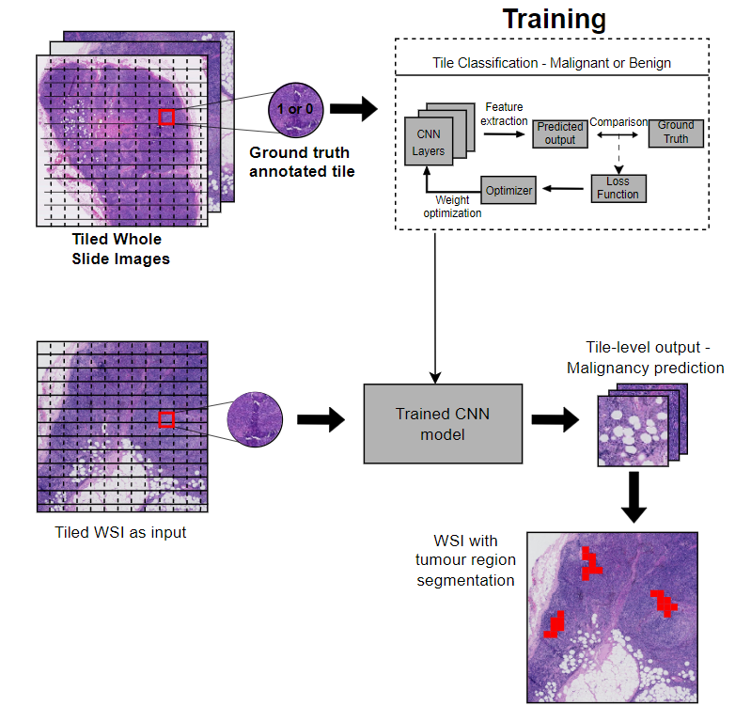
Diagnostic Stage

Slide 10
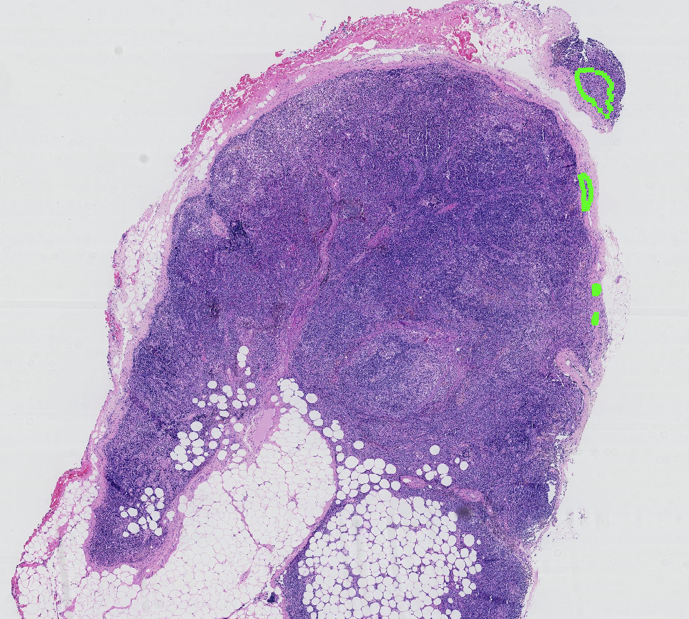
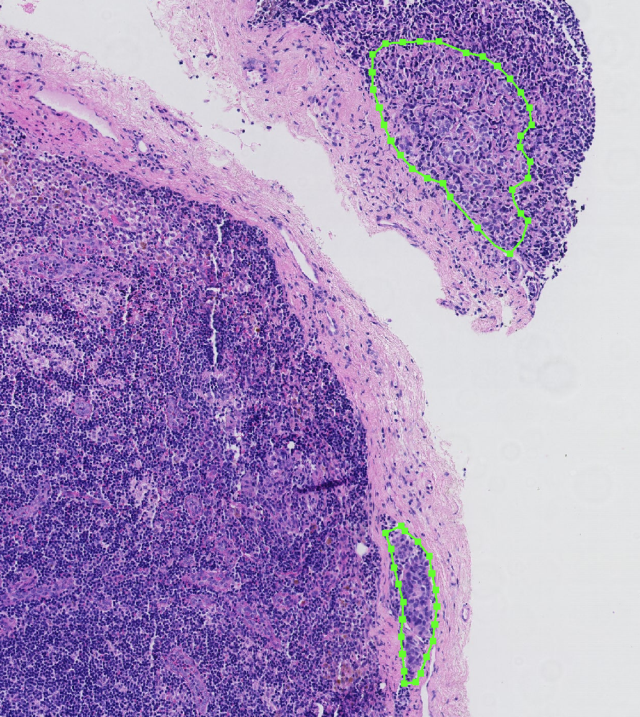
Breast metastases annotated WSI; taken from Camleyon16 dataset.
Core indicators of breast metastases:
Abnormal nuclei growth indicative of regions showing larger Hematoxylin-stained nuclei.
Lower nuclei density and sparse Eosin-stained cytoplasmic regions

Slide 11
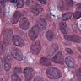
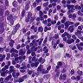
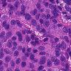
Training Data
Lack of annotated breast cancer data. Infeasible to hire a pathologist and annotate our own dataset.
We used PatchCamelyon (PCAM) dataset – derivative of Camelyon16 challenge data.
Data contains samples of breast metastases in lymph node tissue.
399 WSIs from pathology labs in Netherlands tiled into 96x96 px patches. Each tile is labeled by pathologists with binary annotations (0: benign, 1: malignant)
Balanced training, validation and test sets
We use 100,000 training tiles and 20,000 test and validation tiles

Slide 12
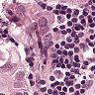
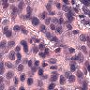
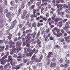
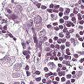
Data Pre-processing
Tiling
Filtering background tiles
Macenko normalization
Augmentation
Un-normalized tiles
Macenko normalized tiles

Slide 13
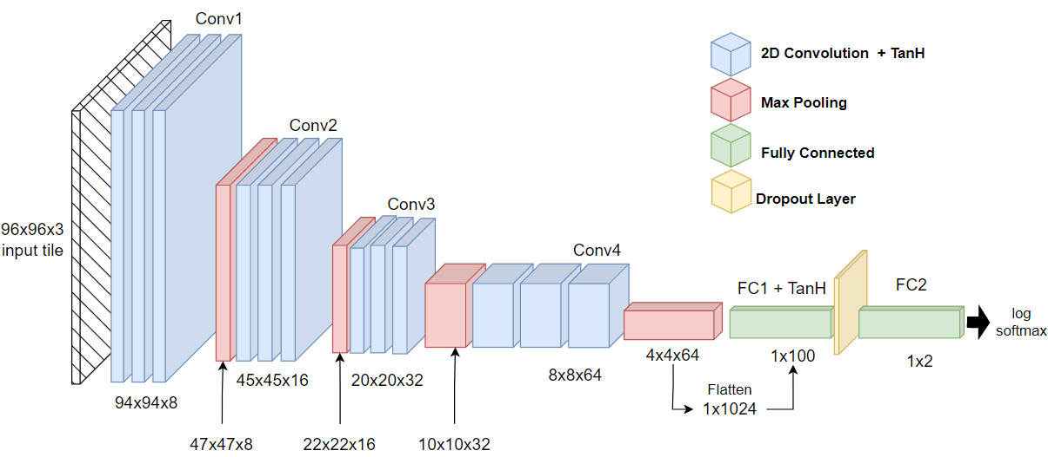
Neural network architecture:

Slide 14
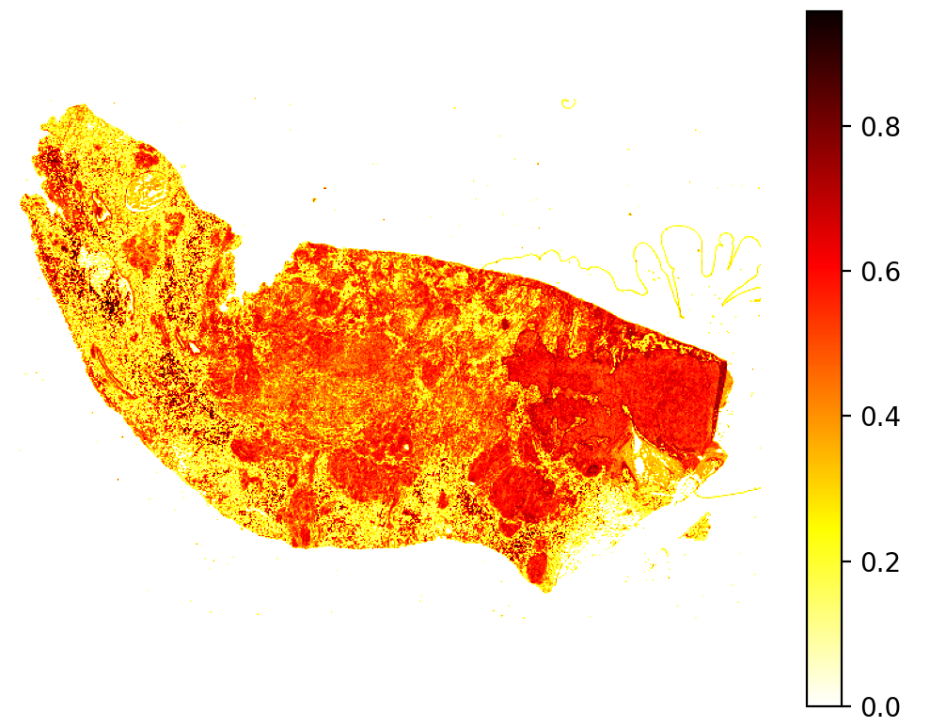
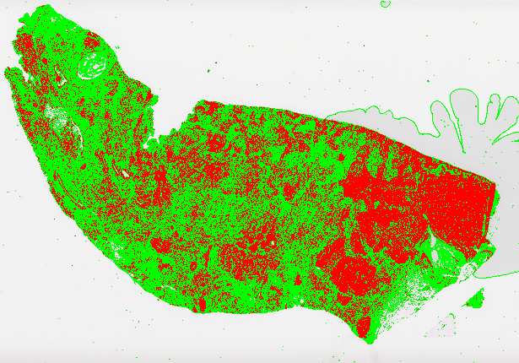
Features extracted from segmented images
1. Mean malignant intensity – Continuous probability predictions. Average probability of malignancy across all tiles of a WSI. Higher MMI indicates more patches of strong malignancy translating to greater disease severity.
2. Malignancy spread score – Discrete binary predictions. Ratio of overall malignant area against total tissue surface area. Higher MSS indicates larger tumor spread and greater disease severity.

Slide 15
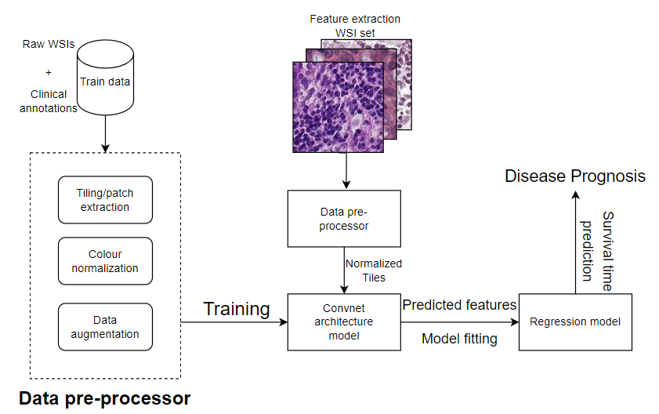
Prognostic Stage

Slide 16
Regression data
Collect breast cancer WSIs of 73 patients from The Cancer Genome Atlas repository
Retrieve each patient’s associated survival duration – time from point of diagnosis to point of death to use as ground-truth in fitting our regression model
Feed each WSI through pre-processor to split them into Maceko normalized tiles of dimension 96x96 px.
Generate metastases predictions for each WSI using our trained model
Calculate MMI and MSS covariate values for each of the 73 WSIs using the tile-level predictions
Combine calculated covariates with the survival duration of each patient to get final regression dataset
Patient id | Survival duration | MMI score | MSS score
TCGA-BH-A1FE | 76.47 | 0.67 | 0.75

Slide 17
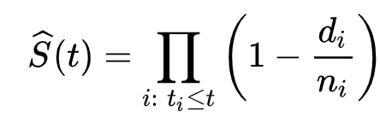
Cox proportional hazards model
Kaplan-meieR method
λ(t|x) = λ₀(t) exp(β_{i}x_{i})
S(t) is the survival function
t is the given time at which we want to estimate survival probability
For each time t_{i} we calculate the ratio between the number of deaths that take place (d_{i}) and the number of subjects that survive at each time (n_{i}).
Non-parametric statistical model
Gives us the probability of survival past time t.
Hazard Ratio exp(β_{i}x_{i}) from Cox model gives the probability of death at each point of time t_{i}
λ(t|x) is the hazard function
t represents time.
x_{i} denotes a vector for each covariate we use for our model.
β is the regression coefficient vector calculated for our model.
λ₀ is the baseline hazard under initial conditions x = 0
Semi-parametric, linear regression model
Gives us a hazard function that represents the hazard

Slide 18
Results

Slide 19
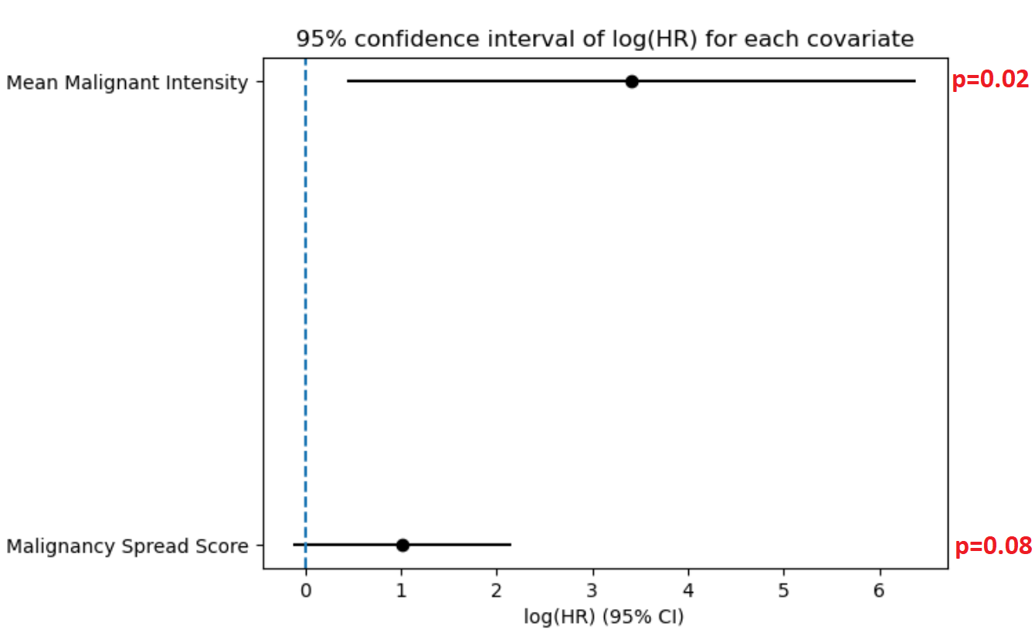
Survival Model fit
Covariate | Exp(β) | z | p
MSS | 2.78 | 1.76 | 0.08
MMI | 30.20 | 2.25 | 0.02
95% Confidence intervals of each model
MMI showed much larger confidence interval indicating more uncertainty in estimating the associated HR but shows statistical significance as null value of HR = 1 is not in the interval
MSS has a shorter interval indicating greater precision in HR estimation but does not show significance as it fails to reject the null value.
The HR value of both models is > 0 indicating both covariates are risk factors negatively effecting survival.
HR of MMI is much higher than MSS implying the severity captured by that covariate has a much stronger correlation with disease hazard.
MMI had a higher z-value than MSS indicating its β coefficient is more statistically different from 0 and has a stronger effect on patient survival.
In survival modeling p<=0.05 is considered significnat
Only the model fitted using MMI covariate showed statistically significant effect on patient survival (p=0.02).

Slide 20
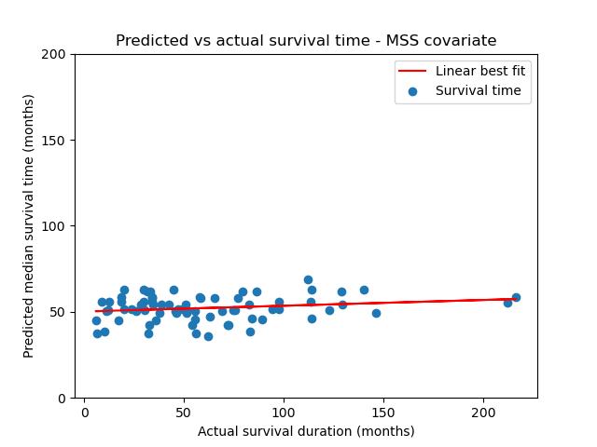
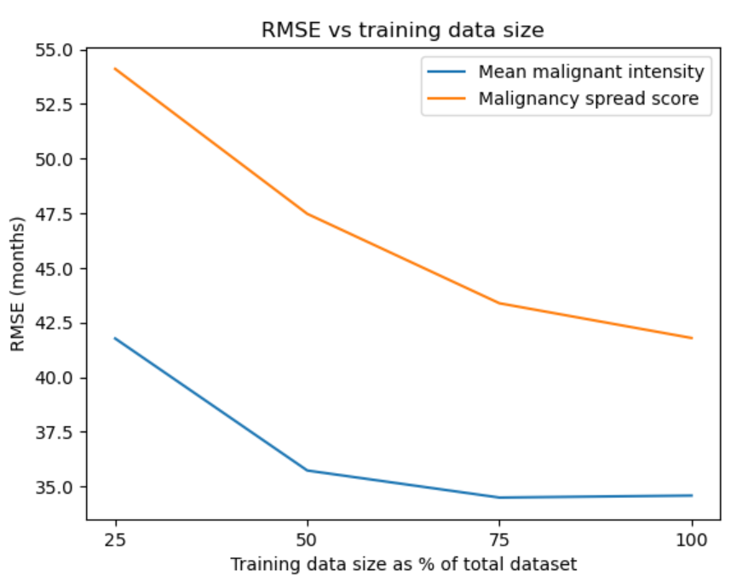
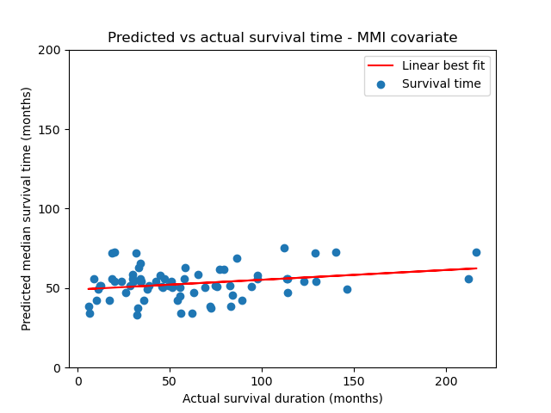
Survival time prediction evaluation
5-fold cross validation results:
Covariate | Mean RMSE (months) | +/- Std deviation (months)
MMI | 47.08 | 29.02
MSS | 47.13 | 29.00
Effect of increasing data on prediction RMSE

Slide 21
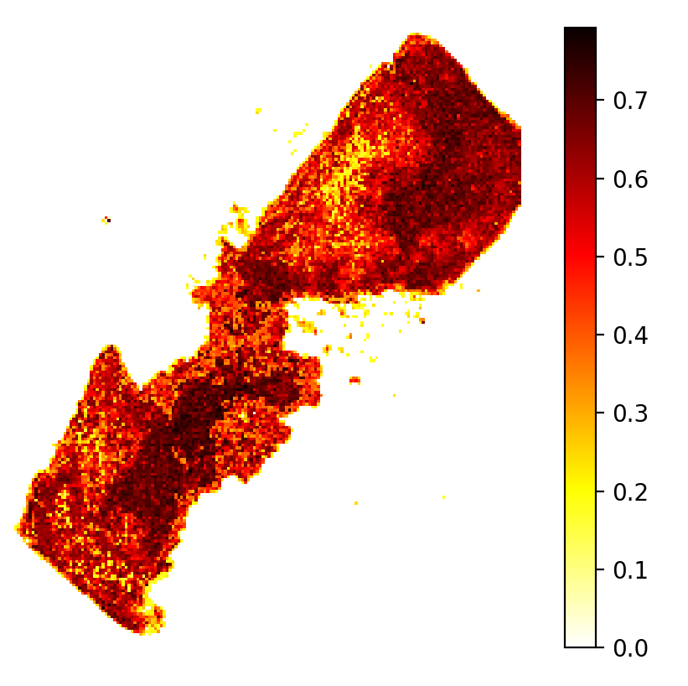
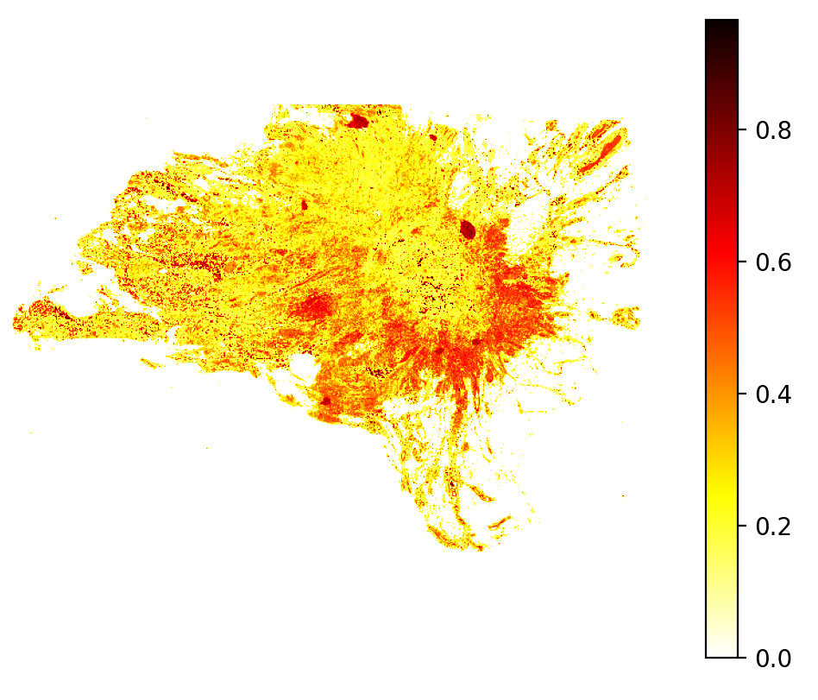
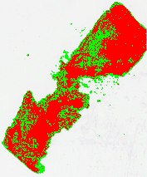
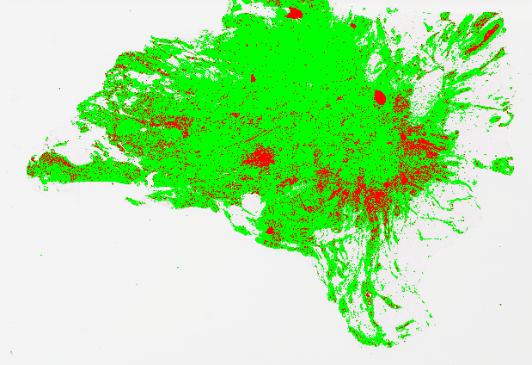
Breast cancer detection performance – qualitative evaluation
Recorded survival duration: 6.47 months
Recorded survival duration: 128.98 months

Slide 22
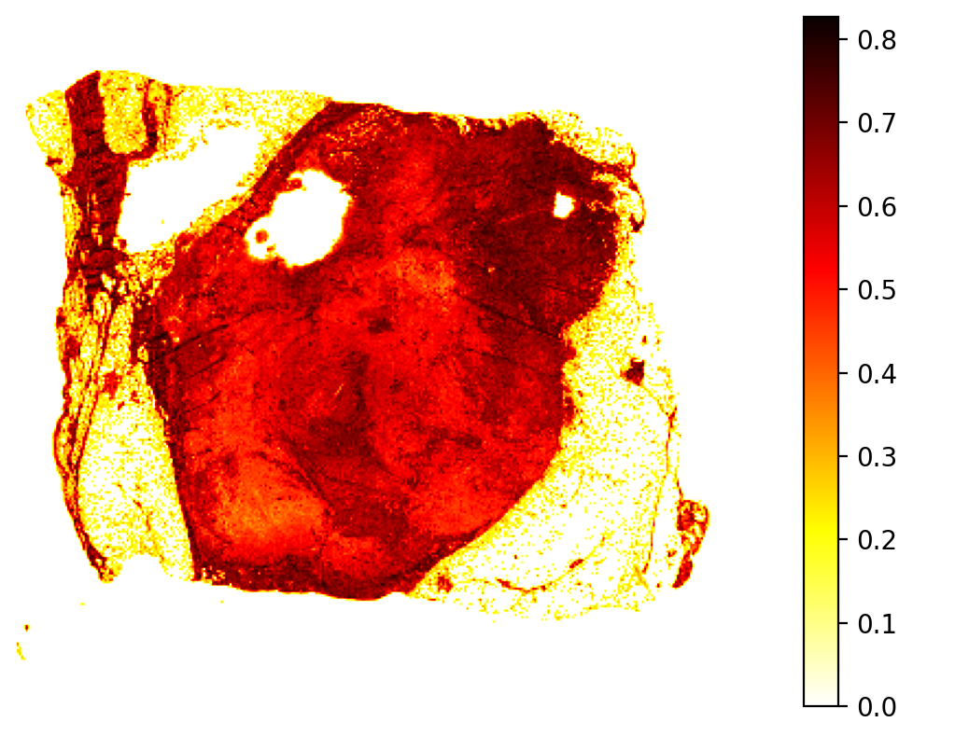
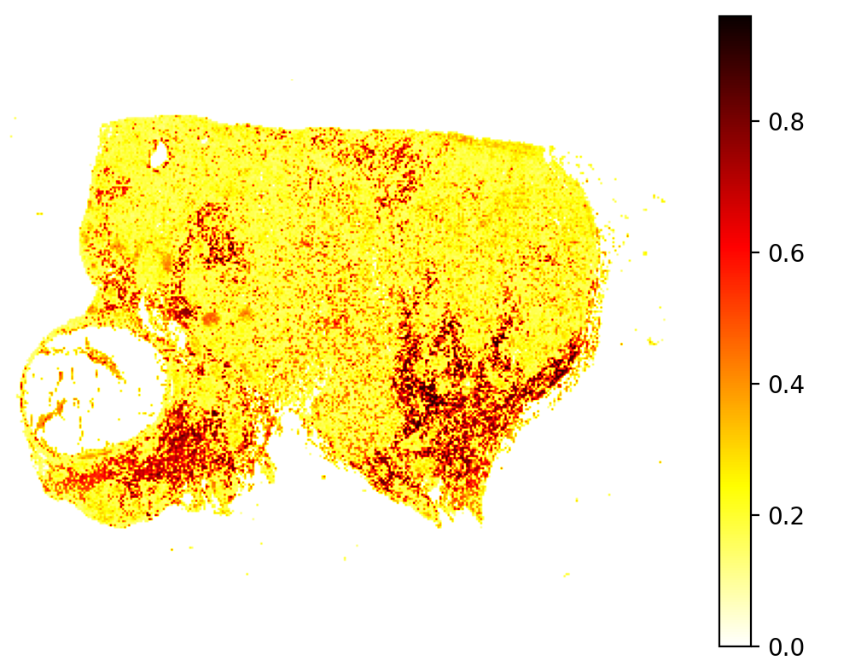
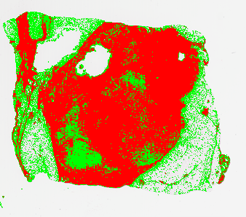
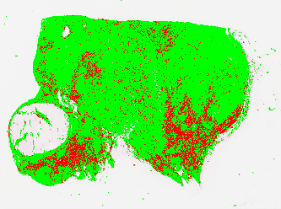
Recorded survival time: 17.21 months
Recorded survival time: 216.59 months

Slide 23
Conclusion

Slide 24
Diagnostic stage:
Internal validation on PCAM data showed up 70% accuracy in malignancy classification.
Despite no quantitative way to evaluate classification performance on TCGA breast samples without pathologist verification, we qualitatively showed that the predicted metastases matches the corresponding survival duration recorded for each sample. High severity predictions correspond to low survival and vice versa.
Learning of breast metastases acquired from lymph node tissue can be transferred to identify metastases in breast tissue to a reasonable degree.
Prognostic stage:
Correlation between image-based features and patient survival was not strong enough to viably use WSIs in exact prognosis estimation without additional clinical data.
This is because patient survival is influenced by several external factors, which univariate hazard models cannot characterize accurately.
It can, however, predict the general trend in survival based on metastases severity which can provide a rough, initial baseline to allow prioritizing high-risk cases for treatment.
Thus, our original goal to minimize delays in the prognostic workflow can still be achieved using WSIs. It can be further improved using multivariate hazard models and including basic clinical data that does not require extensive testing to collect.

